Slide 1

What is Data Driven Decision?

Slide 2



Facts Data Metrices

Slide 3
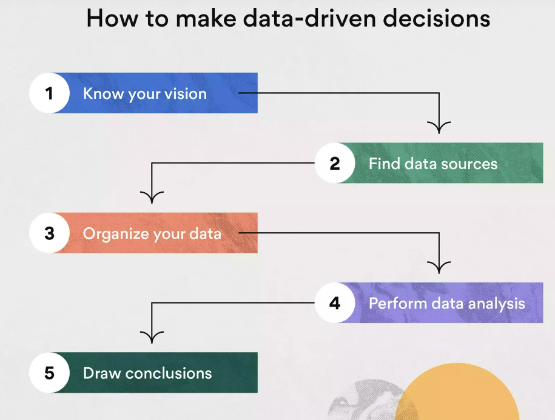

Slide 4


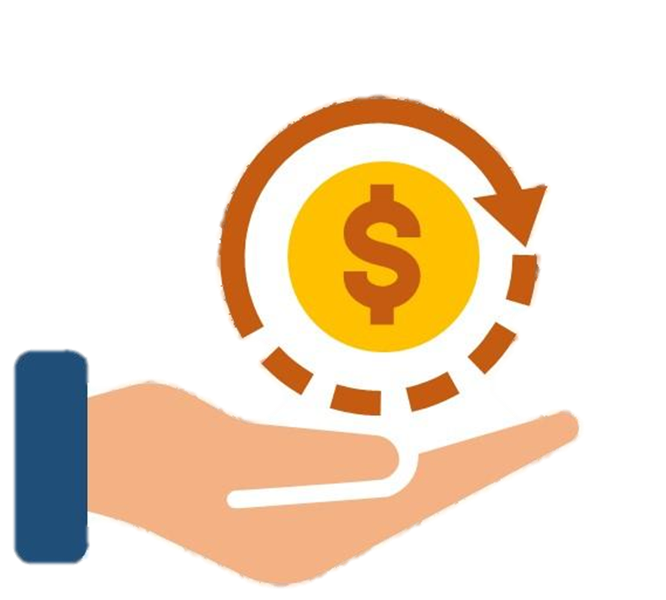

But why it is important?
Improve operational efficiency
Making More Informed Decisions
Cost-Effective Planning
Gain a Competitive Advantage

Slide 5

How data driven decision leverages:
Online Transaction Processing (OLTP)
Online Analytical Processing (OLAP)

Slide 6


OLTP
OLAP
Transactional
Fast processing
Indexed data
Normalized attributes
Current data
Analytics
Data mining
Business intelligence
Machine learning
Historical data
BUSINESS PROCESS
BUSINESS DATA WAREHOUSE
ANALYTICS ROLL UP (“discover similar items”)
ANALYTICS (“business intelligence”)

Slide 7


Slide 8
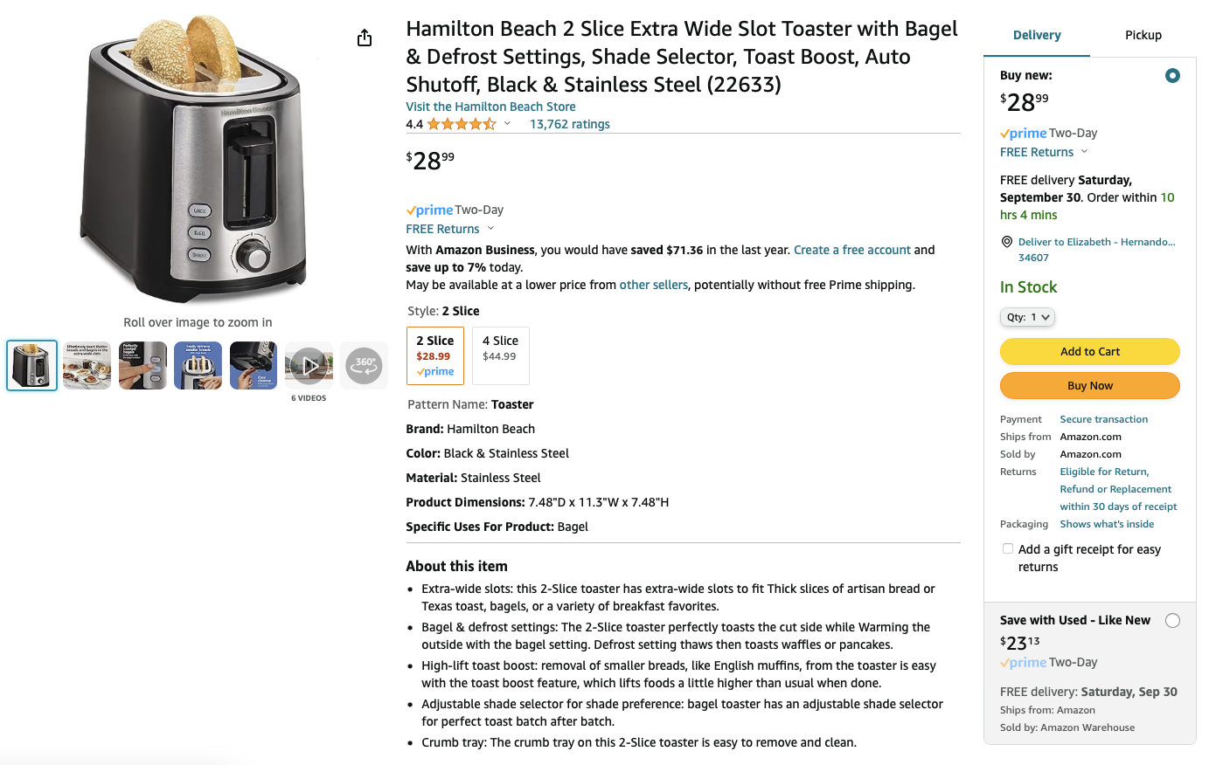
OLTP

Slide 9
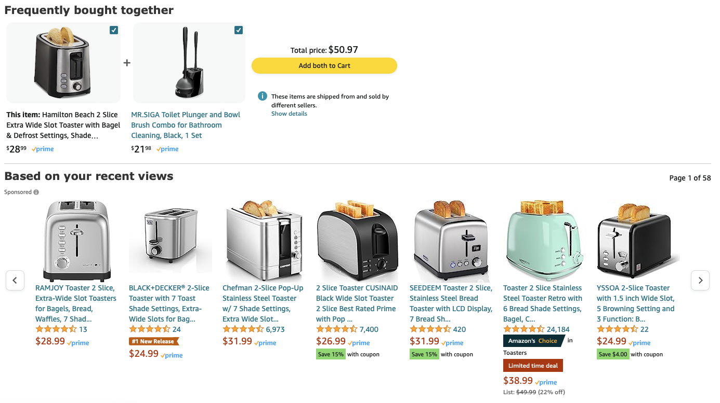
OLAP

Slide 10
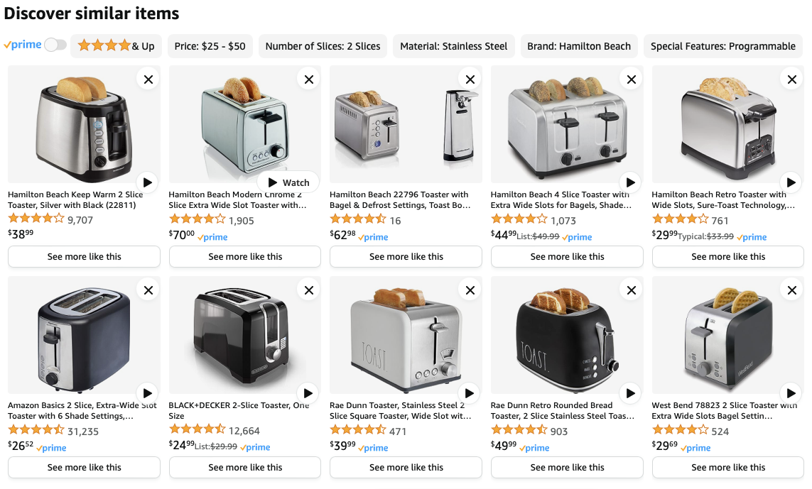
OLAP

Slide 11
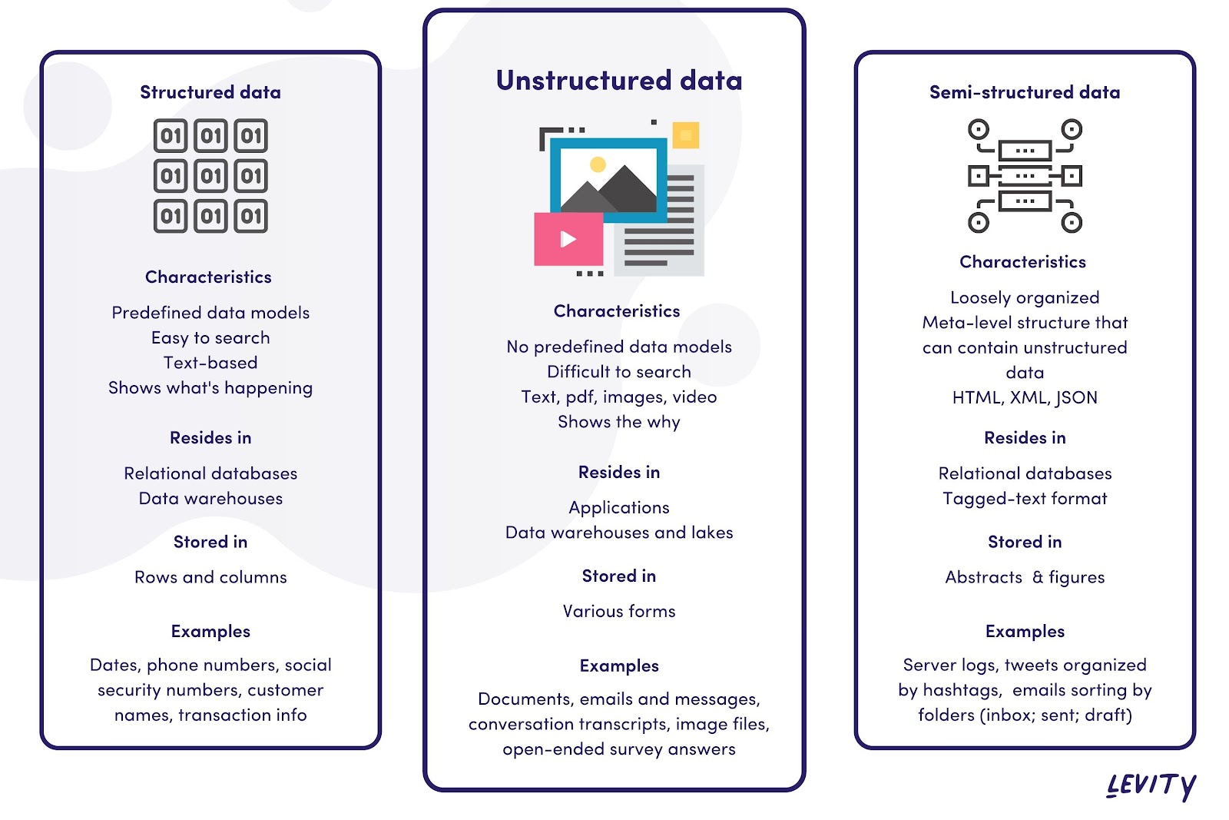
Types of Data
Notes:
Structured data: This is organized data. Or data that can be organized. It's limiting because this type of data has intended purpose.
OLTP is a repository for structured data. It is implicit that it's structured data b/c of the fundamental characteristics and purpose of OLTP systems.
Unstructured data: This type of data has no predefined format or organization. Freeform data because data isn't defined and can be adapted/flexible. More use cases for this type of data. But analysis of unstructured data requires data scientists – specialists to prepare and analyze data.
But in OLAP environments, structured data is NOT generally the norm in the tech industry (think Google, Twitter).
Can store many types of data – structured or unstructured data. In large corporate environments, most OLAP environments store structured data BECAUSE they don't have a business reason to deal with unstructured data.
Semi-structured data: This is Google and Twitter. This type of data doesn't have a strict or predefined schema/data model, but it does have level of structure (usually labels or tags). More flexibility that structured data but not as freeform as unstructured data. Example: semi-structured data can come from log files, sensor data, metadata.

Slide 12
